Slide 1
CH02 Cryptographic Tools
ZJU 2020
Notes:
This chapter provides an overview of computer security. We begin with a discussion
of what we mean by computer security. In essence, computer security deals
with computer-related assets that are subject to a variety of threats and for which
various measures are taken to protect those assets. Accordingly, the next section of
this chapter provides a brief overview of the categories of computer-related assets
that users and system managers wish to preserve and protect, and a look at the
various threats and attacks that can be made on those assets. Then, we survey the
measures that can be taken to deal with such threats and attacks. This we do from
three different viewpoints, in Sections 1.3 through 1.5. We then lay out in general
terms a computer security strategy.
The focus of this chapter, and indeed this book, is on three fundamental
questions:
1. What assets do we need to protect?
2. How are those assets threatened?
3. What can we do to counter those threats?

Slide 2
Outline
Symmetric encryption
Public-key cryptography
Message authentication and hash functions
Digital signatures
Random and pseudorandom numbers
Notes:
Confidentiality with symmetric encryption
Symmetric encryption
Symmetric block encryption algorithms
Stream ciphers
Message authentication and hash functions
Authentication using symmetric encryption
Message authentication without message encryption
Secure hash functions
Other applications of hash functions
Random and pseudorandom numbers
The use of random numbers
Random versus pseudorandom

Slide 3
Terminology
Plaintext
Also called cleartext
Ciphertext
Scrambled message produced as output
Encryption algorithm
Transforms plaintext to ciphertext
Decryption algorithm
Transforms ciphertext to plaintext
Notes:
Public and private key
Pair of keys, one for encryption, one for decryption
Decryption key
Produces the original plaintext

Slide 4
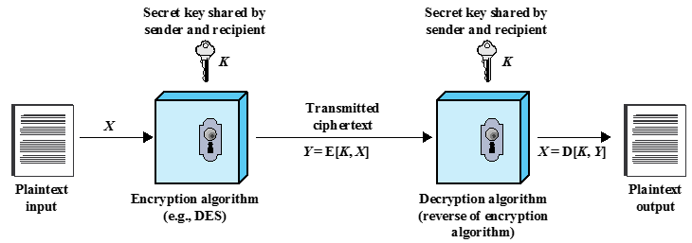
Symmetric Encryption
Also called secret-key cryptography, for protecting confidentiality
Sender and receiver must share the same secret key
Need a strong encryption algorithm
Notes:
The universal technique for providing confidentiality for transmitted or stored
data is symmetric encryption.
This section introduces the basic concept of symmetric encryption. This is followed by an overview of the two most important symmetric encryption algorithms: the Data Encryption Standard (DES) and the Advanced Encryption Standard (AES), which are block encryption algorithms. Finally, this section introduces the concept of symmetric stream encryption algorithms.
Symmetric encryption, also referred to as conventional encryption or single-key
encryption, was the only type of encryption in use prior to the introduction of public-key
encryption in the late 1970s. Countless individuals and groups, from Julius Caesar to the
German U-boat force to present-day diplomatic, military, and commercial users, have
used symmetric encryption for secret communication. It remains the more widely used
of the two types of encryption.
There are two requirements for secure use of symmetric encryption:
1. We need a strong encryption algorithm. At a minimum, we would like the
algorithm to be such that an opponent who knows the algorithm and has
access to one or more ciphertexts would be unable to decipher the ciphertext
or figure out the key. This requirement is usually stated in a stronger form:
The opponent should be unable to decrypt ciphertext or discover the key even
if he or she is in possession of a number of ciphertexts together with the plaintext
that produced each ciphertext.
2. Sender and receiver must have obtained copies of the secret key in a secure
fashion and must keep the key secure. If someone can discover the key and
knows the algorithm, all communication using this key is readable.

Slide 5
Attacking Symmetric Encryption
Cryptanalytic Attacks
Exploits the characteristics of the algorithm to attempt to recover plaintext or secret key
Rely on:
Nature of the algorithm
Some sample plaintext-ciphertext pairs
Some knowledge of the general characteristics of the plaintext, e.g., letter “e” and word “the” are common in English texts
Brute-Force Attacks
Try all possible keys on some ciphertext until an intelligible plaintext is obtained
Notes:
There are two general approaches to attacking a symmetric encryption
scheme. The first attack is known as cryptanalysis. Cryptanalytic attacks rely on
the nature of the algorithm plus perhaps some knowledge of the general characteristics
of the plaintext or even some sample plaintext-ciphertext pairs. This type of
attack exploits the characteristics of the algorithm to attempt to deduce a specific
plaintext or to deduce the key being used. If the attack succeeds in deducing the
key, the effect is catastrophic: All future and past messages encrypted with that key
are compromised.
The second method, known as the brute-force attack, is to try every possible
key on a piece of ciphertext until an intelligible translation into plaintext is obtained.
On average, half of all possible keys must be tried to achieve success.

Slide 6
Block & Stream Ciphers
Block Cipher
Processes input data one block at a time
Produces an output block for each input block
Stream Cipher
Processes the input elements continuously, producing output one element at a time
One element may be 1 bit, 1 Byte, or more than 1 Byte
Faster than block ciphers
Notes:
A block cipher processes the input one block of elements at a time, producing an
output block for each input block. A stream cipher processes the input elements
continuously, producing output one element at a time, as it goes along. Although
block ciphers are far more common, there are certain applications in which a stream
cipher is more appropriate. Examples are given subsequently in this book.
A typical stream cipher encrypts plaintext one byte at a time, although a stream
cipher may be designed to operate on one bit at a time or on units larger than a byte
at a time.
With a properly designed pseudorandom number generator, a stream cipher
can be as secure as block cipher of comparable key length. The primary advantage
of a stream cipher is that stream ciphers are almost always faster and use far less
code than do block ciphers. The advantage of a block cipher is that you can reuse
keys. For applications that require encryption/decryption of a stream of data, such as
over a data communications channel or a browser/Web link, a stream cipher might
be the better alternative. For applications that deal with blocks of data, such as file
transfer, e-mail, and database, block ciphers may be more appropriate. However,
either type of cipher can be used in virtually any application.
Pseudorandom stream is unpredictable without knowledge of the input key

Slide 7
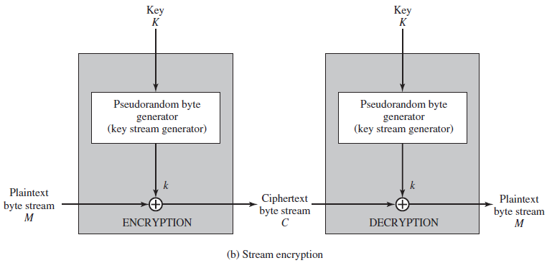
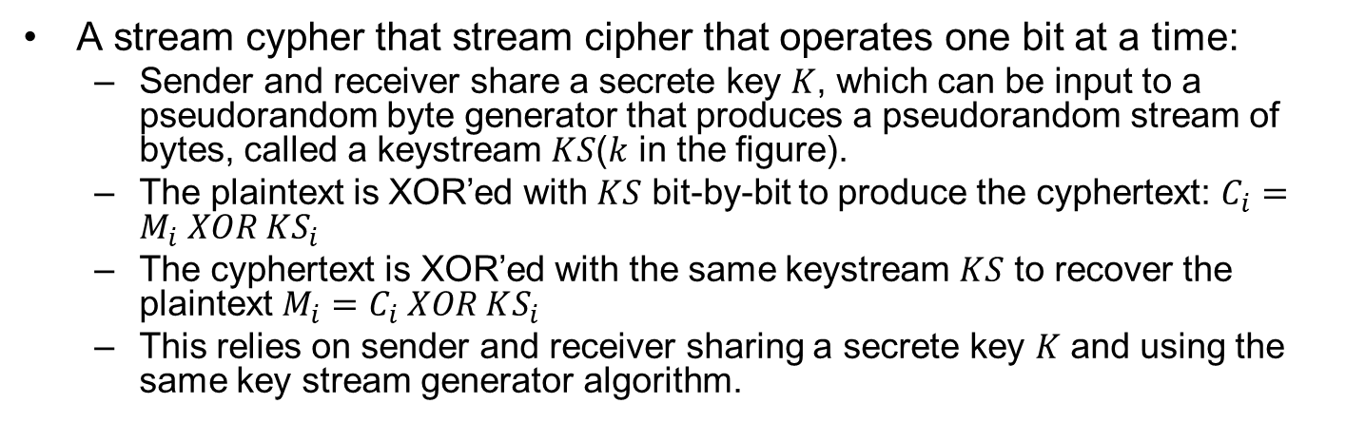
An Example Stream Cypher
A stream cypher that stream cipher that operates one bit at a time:
Sender and receiver share a secrete key $K$, which can be input to a pseudorandom byte generator that produces a pseudorandom stream of bytes, called a keystream $KS$($k$ in the figure).
The plaintext is XOR’ed with $KS$ bit-by-bit to produce the cyphertext: $C_{i}=M_{i} XOR KS_{i}$
The cyphertext is XOR’ed with the same keystream $KS$ to recover the plaintext $M_{i}=C_{i} XOR KS_{i}$
This relies on sender and receiver sharing a secrete key $K$ and using the same key stream generator algorithm.
Notes:
Typically, symmetric encryption is applied to a
unit of data larger than a single 64-bit or 128-bit block. E-mail messages, network
packets, database records, and other plaintext sources must be broken up into a
series of fixed-length block for encryption by a symmetric block cipher. The simplest
approach to multiple-block encryption is known as electronic codebook (ECB)
mode, in which plaintext is handled b bits at a time and each block of plaintext is
encrypted using the same key. Typically b =64 or b =128
For lengthy messages, the ECB mode may not be secure. A cryptanalyst may
be able to exploit regularities in the plaintext to ease the task of decryption. For
example, if it is known that the message always starts out with certain predefined
fields, then the cryptanalyst may have a number of known plaintext-ciphertext pairs
to work with.
To increase the security of symmetric block encryption for large sequences
of data, a number of alternative techniques have been developed, called modes of
operation. These modes overcome the weaknesses of ECB; each mode has its own
particular advantages. This topic is explored in Chapter 20. Figure 2.2a shows the
ECB mode. A plaintext of length nb is divided into n b-bit blocks (P₁, P₂,….,P_{n}).
Each block is encrypted using the same algorithm and the same encryption key, to
produce a sequence of n b-bit blocks of ciphertext (C₁, C₂,….,C_{n}).
Figure 2.2b is a representative diagram of stream cipher structure. In this
structure a key is input to a pseudorandom bit generator that produces a stream
of 8-bit numbers that are apparently random. A pseudorandom stream is one that
is unpredictable without knowledge of the input key and which has an apparently
random character (see Section 2.5). The output of the generator, called a keystream,
is combined one byte at a time with the plaintext stream using the bitwise exclusive-
OR (XOR) operation.
is combined one byte at a time with the plaintext stream using the bitwise exclusive-
OR (XOR) operation.
A pseudo-random keystream XOR’ed with plaintext bit-by-bit:

Slide 8
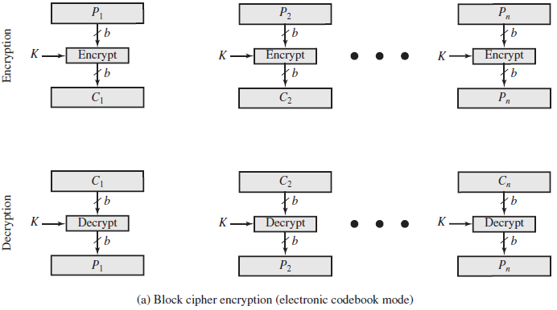

Block Cipher: Electronic CodeBook (ECB)
Each plaintext block $P_{i}$ (e.g., 64 or 128 bits) is encoded independently using the same key $K$
Attacker may exploit regularities in the plaintext to perform cryptoanalysis, since same plaintext block generates same cyphertext block. If it is known that the message always starts out with certain predefined fields, then the cryptanalyst may have a number of known plaintext-ciphertext pairs to work with.
Notes:
Typically, symmetric encryption is applied to a
unit of data larger than a single 64-bit or 128-bit block. E-mail messages, network
packets, database records, and other plaintext sources must be broken up into a
series of fixed-length block for encryption by a symmetric block cipher. The simplest
approach to multiple-block encryption is known as electronic codebook (ECB)
mode, in which plaintext is handled b bits at a time and each block of plaintext is
encrypted using the same key. Typically b =64 or b =128
For lengthy messages, the ECB mode may not be secure. A cryptanalyst may
be able to exploit regularities in the plaintext to ease the task of decryption. For
example, if it is known that the message always starts out with certain predefined
fields, then the cryptanalyst may have a number of known plaintext-ciphertext pairs
to work with.
To increase the security of symmetric block encryption for large sequences
of data, a number of alternative techniques have been developed, called modes of
operation. These modes overcome the weaknesses of ECB; each mode has its own
particular advantages. This topic is explored in Chapter 20. Figure 2.2a shows the
ECB mode. A plaintext of length nb is divided into n b-bit blocks (P₁, P₂,….,P_{n}).
Each block is encrypted using the same algorithm and the same encryption key, to
produce a sequence of n b-bit blocks of ciphertext (C₁, C₂,….,C_{n}).
Attacker may reorder blocks of ciphertext, then each block will still decrypt successfully, but message content is altered.

Slide 9
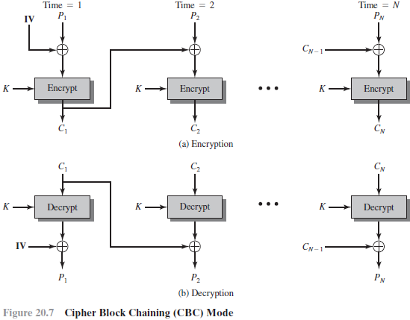
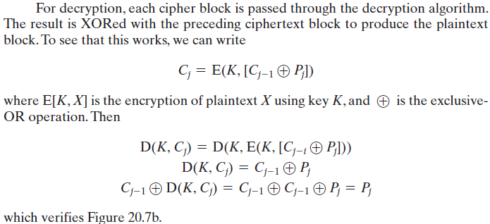

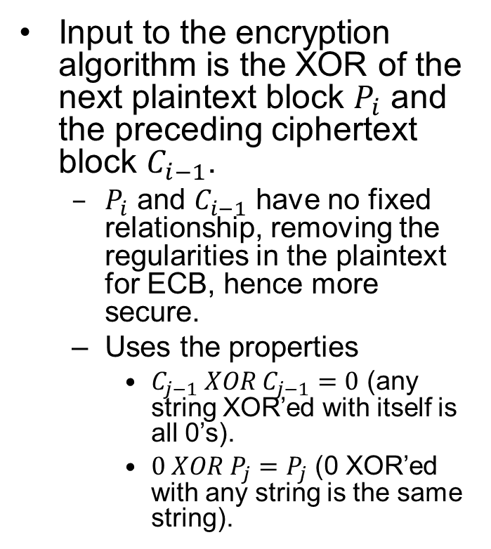
Block Cipher: Cipher Block Chaining (CBC)
Input to the encryption algorithm is the XOR of the next plaintext block $P_{i}$ and the preceding ciphertext block $C_{i−1}$.
$P_{i}$ and $C_{i−1}$ have no fixed relationship, removing the regularities in the plaintext for ECB, hence more secure.
Uses the properties
$C_{j−1} XOR C_{j−1}=0$ (any string XOR’ed with itself is all 0’s).
$0 XOR P_{j}=P_{j}$ (0 XOR’ed with any string is the same string).
Notes:
to perform cryptoanalysis. Therefore, repeating patterns of b-bits are not exposed

Slide 10
Comparison of 3 Symmetric Encryption Standards (Block Ciphers)
Notes:
The most commonly used symmetric encryption algorithms are block ciphers. A block cipher processes the plaintext input in fixed-size blocks and produces a block of ciphertext of equal size for each plaintext block. The algorithm processes longer plaintext amounts as a series of fixed-size blocks. The most important symmetric algorithms, all of which are block ciphers, are the Data Encryption Standard (DES), triple DES, and the Advanced Encryption Standard (AES); see Table 2.1. This subsection provides an overview of these algorithms. Chapter 20 presents the technical details.

Slide 11
Data Encryption Standard (DES)
DES Uses 64-bit plaintext block and 56-bit key to produce a 64-bit ciphertext block
Key length of 56 bits is too short, and subject to brute-force attacks.
Should no longer be used in production systems.
Notes:
Federal Information Processing Standards Publications (FIPS PUBS)
The most widely used encryption scheme is based
on the Data Encryption Standard (DES) adopted in 1977 by the National Bureau
of Standards, now the National Institute of Standards and Technology (NIST), as
Federal Information Processing Standard 46 (FIPS PUB 46). The algorithm itself is
referred to as the Data Encryption Algorithm (DEA). DES takes a plaintext block
of 64 bits and a key of 56 bits, to produce a ciphertext block of 64 bits.
Concerns about the strength of DES fall into two categories: concerns about
the algorithm itself and concerns about the use of a 56-bit key. The first concern
refers to the possibility that cryptanalysis is possible by exploiting the characteristics
of the DES algorithm. Over the years, there have been numerous attempts to find
and exploit weaknesses in the algorithm, making DES the most-studied encryption
algorithm in existence. Despite numerous approaches, no one has so far reported a
fatal weakness in DES.
A more serious concern is key length. With a key length of 56 bits, there are 2^56
possible keys, which is approximately 7.2x10^16 keys. Thus, on the face of it, a brute-force
attack appears impractical. Assuming that, on average, half the key space has
to be searched, a single machine performing one DES encryption per micro second
would take more than a thousand years (see Table 2.1) to break the cipher.
However, the assumption of one encryption per microsecond is overly conservative.
DES finally and definitively proved insecure in July 1998, when the
Electronic Frontier Foundation (EFF) announced that it had broken a DES encryption
using a special-purpose “DES cracker” machine that was built for less than
$250,000. The attack took less than three days. The EFF has published a detailed
description of the machine, enabling others to build their own cracker [EFF98].
And, of course, hardware prices will continue to drop as speeds increase, making
DES virtually worthless.
It is important to note that there is more to a key-search attack than simply running
through all possible keys. Unless known plaintext is provided, the analyst must
be able to recognize plaintext as plaintext. If the message is just plain text in English,
then the result pops out easily, although the task of recognizing English would have to
be automated. If the text message has been compressed before encryption, then recognition
is more difficult. And if the message is some more general type of data, such
as a numerical file, and this has been compressed, the problem becomes even more
difficult to automate. Thus, to supplement the brute-force approach, some degree of
knowledge about the expected plaintext is needed, and some means of automatically
distinguishing plaintext from garble is also needed. The EFF approach addresses this
issue as well and introduces some automated techniques that would be effective in
many contexts.
A final point: If the only form of attack that could be made on an encryption
algorithm is brute force, then the way to counter such attacks is obvious: Use longer
keys. To get some idea of the size of key required, let us use the EFF cracker as a
basis for our estimates. The EFF cracker was a prototype and we can assume that
with today’s technology, a faster machine is cost effective. If we assume that a cracker
can perform 1 million decryptions per μs, which is the rate used in Table 2.1, then a
DES code would take about 10 hours to crack. This is a speed-up of approximately
a factor of 7 compared to the EFF result

Slide 12
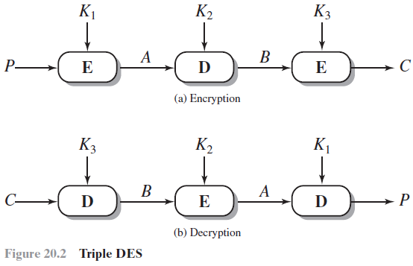
Triple DES (3DES)
Repeats DES three times using either 2 or 3 unique keys, with total key length of 112 or 168 bits
Pros:
Key length of 168 bits removes the vulnerability to brute-force attacks
Cons:
Performance is slow: three times as many calculations as DES.
A block size larger than 64 bits is desirable for efficiency and security.
Notes:
The life of DES was extended by the use of triple DES (3DES),
which involves repeating the basic DES algorithm three times, using either two
or three unique keys, for a key size of 112 or 168 bits. Triple DES (3DES) was
first standardized for use in financial applications in ANSI standard X9.17 in 1985.
3DES was incorporated as part of the Data Encryption Standard in 1999, with the
publication of FIPS PUB 46-3.
3DES has two attractions that assure its widespread use over the next few
years. First, with its 168-bit key length, it overcomes the vulnerability to brute-force
attack of DES. Second, the underlying encryption algorithm in 3DES is the same as
in DES. This algorithm has been subjected to more scrutiny than any other encryption
algorithm over a longer period of time, and no effective cryptanalytic attack
based on the algorithm rather than brute force has been found. Accordingly, there
is a high level of confidence that 3DES is very resistant to cryptanalysis. If security
were the only consideration, then 3DES would be an appropriate choice for a standardized
encryption algorithm for decades to come.
The principal drawback of 3DES is that the algorithm is relatively sluggish in
software. The original DES was designed for mid-1970s hardware implementation
and does not produce efficient software code. 3DES, which requires three times as
many calculations as DES, is correspondingly slower. A secondary drawback is that
both DES and 3DES use a 64-bit block size. For reasons of both efficiency and security,
a larger block size is desirable.

Slide 13
Advanced Encryption Standard (AES)
Due to performance and block size issues with 3DES, NIST called for proposals for a new Advanced Encryption Standard (AES) in 1997, and made a selection in 2001.
128-bit block size and key length of 128, 192 or 256 bits
AES is now widely deployed commercially.
Notes:
Because of its drawbacks, 3DES is not a
reasonable candidate for long-term use. As a replacement, NIST in 1997 issued a
call for proposals for a new Advanced Encryption Standard (AES), which should
have a security strength equal to or better than 3DES and significantly improved
efficiency. In addition to these general requirements, NIST specified that AES must
be a symmetric block cipher with a block length of 128 bits and support for key
lengths of 128, 192, and 256 bits. Evaluation criteria included security, computational
efficiency, memory requirements, hardware and software suitability, and flexibility.
In a first round of evaluation, 15 proposed algorithms were accepted. A
second round narrowed the field to 5 algorithms. NIST completed its evaluation
process and published a final standard (FIPS PUB 197) in November of 2001. NIST
selected Rijndael as the proposed AES algorithm. AES is now widely available in
commercial products. AES is described in detail in Chapter 20.

Slide 14
Time Required for Brute-Force Attack
Notes:
Table 2.2 shows how much time is required for
a brute-force attack for various key sizes. As can be seen, a single PC can break
DES in about a year; if multiple PCs work in parallel, the time is drastically shortened.
And today’s supercomputers should be able to find a key in about an hour.
Key sizes of 128 bits or greater are effectively unbreakable using simply a brute-force
approach. Even if we managed to speed up the attacking system by a factor
of 1 trillion (10¹² ), it would still take over 100,000 years to break a code using a
128-bit key.

Slide 15
Public-Key Cryptography
Proposed by Diffie and Hellman in 1976
Based on modular arithmetic functions
Asymmetric: uses two separate keys
Public key and private key
Notes:
Public key is made public for others to use
Public-key encryption, first publicly proposed by Diffie and Hellman in 1976
[DIFF76], is the first truly revolutionary advance in encryption in literally thousands
of years. Public-key algorithms are based on mathematical functions rather than on
simple operations on bit patterns, such as are used in symmetric encryption algorithms.
More important, public-key cryptography is asymmetric, involving the use
of two separate keys, in contrast to symmetric encryption, which uses only one key.
The use of two keys has profound consequences in the areas of confidentiality, key
distribution, and authentication.
Before proceeding, we should first mention several common misconceptions
concerning public-key encryption. One is that public-key encryption is more secure
from cryptanalysis than symmetric encryption. In fact, the security of any encryption
scheme depends on (1) the length of the key and (2) the computational work involved
in breaking a cipher. There is nothing in principle about either symmetric or public-key
encryption that makes one superior to another from the point of view of resisting cryptanalysis.
A second misconception is that public-key encryption is a general- purpose
technique that has made symmetric encryption obsolete. On the contrary, because of
the computational overhead of current public-key encryption schemes, there seems no
foreseeable likelihood that symmetric encryption will be abandoned. Finally, there is
a feeling that key distribution is trivial when using public-key encryption, compared to
the rather cumbersome handshaking involved with key distribution centers for symmetric
encryption. For public-key key distribution, some form of protocol is needed,
often involving a central agent, and the procedures involved are no simpler or any
more efficient than those required for symmetric encryption.
As the names suggest, the public key of the pair is made public for others to
use, while the private key is known only to its owner. A general-purpose public-key
cryptographic algorithm relies on one key for encryption and a different but related
key for decryption.

Slide 16
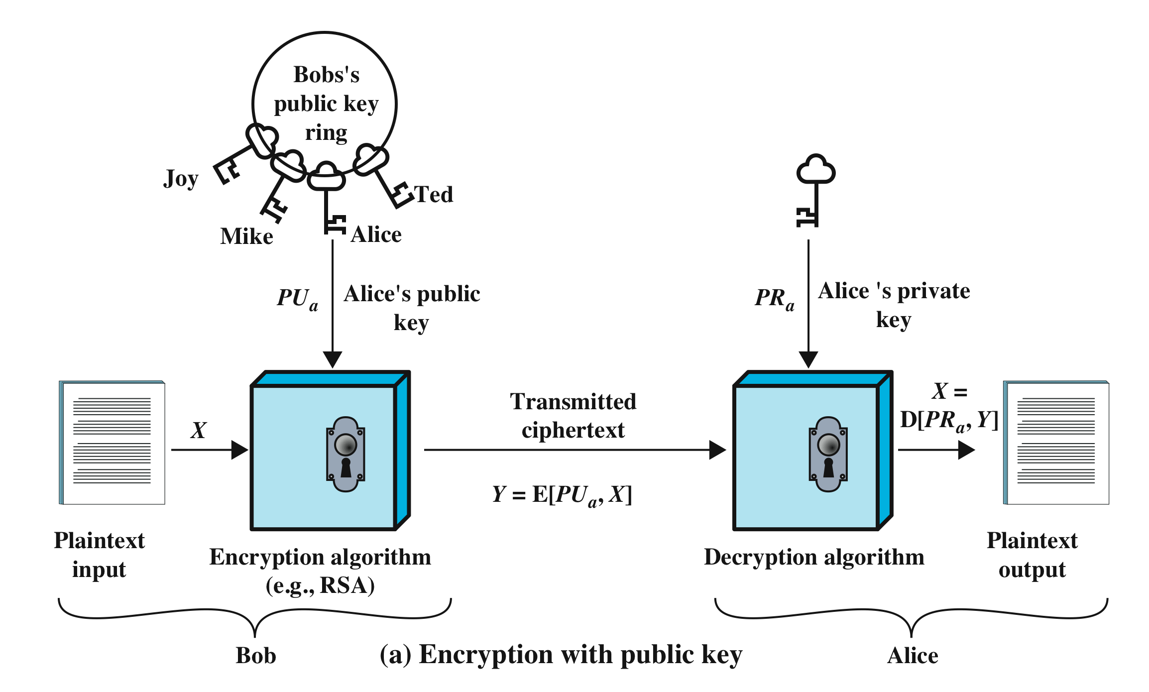
Public-Key Crypto for Confidentiality
Sender encrypts data using the receiver’s public key
Receiver decrypts data using his own private key
Use of a public/private key pair removes the need for sharing a secret key
Notes:
A public-key encryption scheme has six ingredients (Figure 2.6a):
• Plaintext: This is the readable message or data that is fed into the algorithm as
input.
• Encryption algorithm: The encryption algorithm performs various transformations
on the plaintext.
• Public and private key: This is a pair of keys that have been selected so that
if one is used for encryption, the other is used for decryption. The exact
transformations performed by the encryption algorithm depend on the public
or private key that is provided as input.
Ciphertext: This is the scrambled message produced as output. It depends on
the plaintext and the key. For a given message, two different keys will produce
two different ciphertexts.
• Decryption algorithm: This algorithm accepts the ciphertext and the matching
key and produces the original plaintext.
As the names suggest, the public key of the pair is made public for others to
use, while the private key is known only to its owner. A general-purpose public-key
cryptographic algorithm relies on one key for encryption and a different but related
key for decryption.
The essential steps are the following:
1. Each user generates a pair of keys to be used for the encryption and decryption
of messages.
2. Each user places one of the two keys in a public register or other accessible
file. This is the public key. The companion key is kept private. As Figure 2.6a
suggests, each user maintains a collection of public keys obtained from others.
3. If Bob wishes to send a private message to Alice, Bob encrypts the message
using Alice’s public key.
4. When Alice receives the message, she decrypts it using her private key. No
other recipient can decrypt the message because only Alice knows Alice’s private
key.
With this approach, all participants have access to public keys, and private keys
are generated locally by each participant and therefore need never be distributed.
As long as a user protects his or her private key, incoming communication is secure.
At any time, a user can change the private key and publish the companion public
key to replace the old public key.
Note that the scheme of Figure 2.6a is directed toward providing confidentiality:
Only the intended recipient should be able to decrypt the ciphertext because only
the intended recipient is in possession of the required private key. Whether in fact
confidentiality is provided depends on a number of factors, including the security of
the algorithm, whether the private key is kept secure, and the security of any protocol
of which the encryption function is a part.

Slide 17
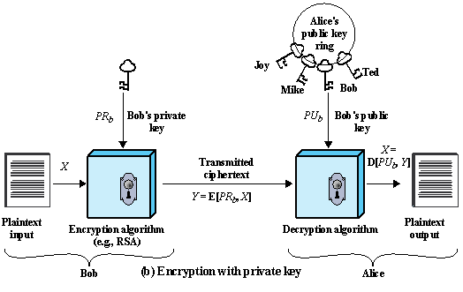
Public-Key Crypto for Integrity
Sender encrypts data using his or her private key
Receiver, or anyone else, can decrypt the message using sender’s public key.
There are more efficient methods based on MAC or crypto hash function (discussed later).
Notes:
Figure 2.6b illustrates another mode of operation of public-key cryptography.
In this scheme, a user encrypts data using his or her own private key.
Anyone who knows the corresponding public key will then be able to decrypt the
message.
The scheme of Figure 2.6b is directed toward providing authentication
and/or data integrity. If a user is able to successfully recover the plaintext from
Bob’s ciphertext using Bob’s public key, this indicates that only Bob could have
encrypted the plaintext, thus providing authentication. Further, no one but
Bob would be able to modify the plaintext because only Bob could encrypt the
plaintext with Bob’s private key. Once again, the actual provision of authentication
or data integrity depends on a variety of factors. This issue is addressed
primarily in Chapter 21, but other references are made to it where appropriate in
this text.

Slide 18
Public-Key Crypto Algorithms and Protocols
RSA (Rivest-Shamir-Adelman)
Key generation, encryption, decryption
Elliptic Curve Cryptography (ECC)
Lightweight public key algorithm for embedded and IoT devices
Diffie-Hellman
Key exchange protocol used to establish a shared secret between two parties, e.g., a secret key for symmetric encryption
Notes:
Before proceeding, we need to clarify one aspect of public-key cryptosystems that is
otherwise likely to lead to confusion. Public-key systems are characterized by the use
of a cryptographic type of algorithm with two keys, one held private and one available
publicly. Depending on the application, the sender uses either the sender’s private key
or the receiver’s public key, or both, to perform some type of cryptographic function.
In broad terms, we can classify the use of public-key cryptosystems into three categories:
digital signature, symmetric key distribution, and encryption of secret keys.
These applications are discussed in Section 2.4. Some algorithms are suitable
for all three applications, whereas others can be used only for one or two of
these applications. Table 2.3 indicates the applications supported by the algorithms
discussed
in this section. (DSS: Digital Signature Standard)

Slide 19
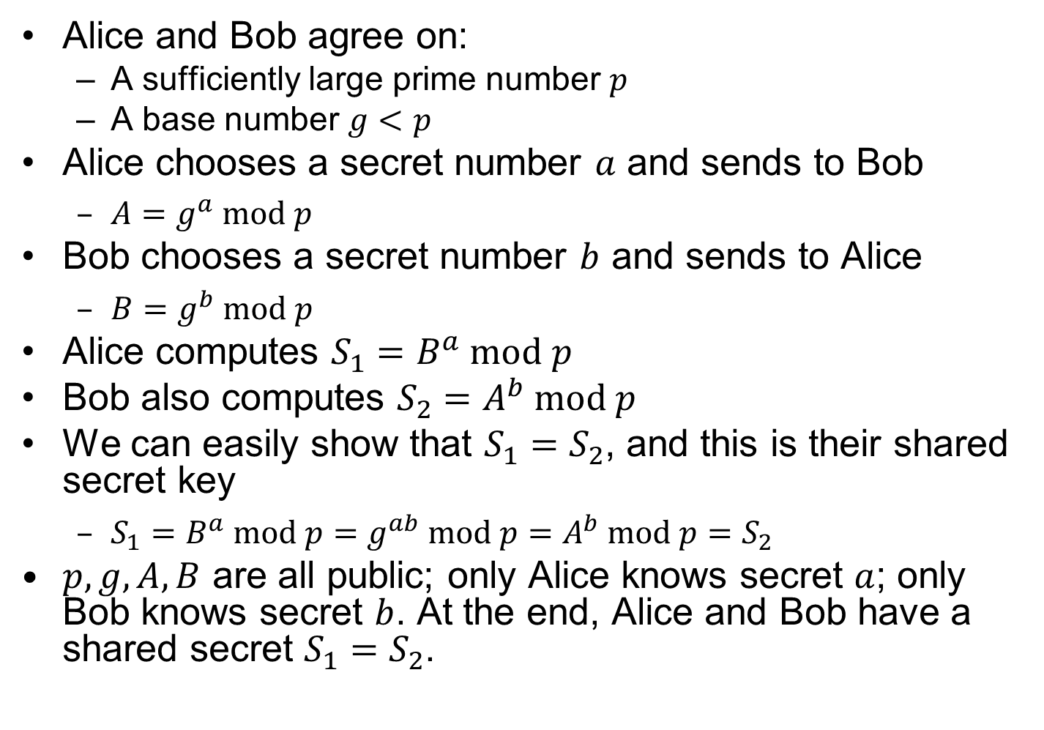
Diffie-Hellman
Alice and Bob agree on:
A sufficiently large prime number $p$
A base number $g<p$
Alice chooses a secret number $a$ and sends to Bob
$A=g^{a} mod p$
Bob chooses a secret number $b$ and sends to Alice
$B=g^{b} mod p$
Alice computes $S_{1}=B^{a} mod p$
Bob also computes $S_{2}=A^{b} mod p$
We can easily show that $S_{1}=S_{2}$, and this is their shared secret key
$S_{1}=B^{a} mod p=g^{ab} mod p=A^{b} mod p=S_{2}$
$p,g,A,B$ are all public; only Alice knows secret $a$; only Bob knows secret $b$. At the end, Alice and Bob have a shared secret $S_{1}=S_{2}$.
Notes:
Public Key Generation
$A,B,p,g$ are all public; only $A$ knows secret $a$; only $B$ knows secret $b$.

Slide 20
Requirements for Public-Key Crypto
Computationally easy to
create key pairs
encrypt/decrypt messages using either public or private key
Computationally infeasible to
determine private key from public key
recover cleartext without key
Either key can be used for each role (public/private key)
Notes:
The cryptosystem illustrated in Figure 2.6 depends on a cryptographic algorithm
based on two related keys. Diffie and Hellman postulated this system without demonstrating
that such algorithms exist. However, they did lay out the conditions that
such algorithms must fulfill [DIFF76]:
RSA (Rivest, Shamir, Adleman)
Developed in 1977
Most widely accepted and implemented approach to public-key encryption
Block cipher in which the plaintext and ciphertext are integers between 0 and n-1 for some n.
Diffie-Hellman key exchange algorithm
Enables two users to securely reach agreement about a shared secret that can be used as a secret key for subsequent symmetric encryption of messages
Limited to the exchange of the keys
Digital Signature Standard (DSS)
Provides only a digital signature function with SHA-1
Cannot be used for encryption or key exchange
Elliptic curve cryptography (ECC)
Security like RSA, but with much smaller keys

Slide 21
Message Authentication
Verifies received message is authentic
Its content has not been altered (authentic content), and it is from the alleged sender (authentic source)
Can use encryption (symmetric or public-key)
Sender encrypts the message, receiver decrypts it
But inefficient for large messages
Notes:
Encryption protects against passive attack (eavesdropping). A different requirement
is to protect against active attack (falsification of data and transactions). Protection
against such attacks is known as message or data authentication.
A message, file, document, or other collection of data is said to be authentic
when it is genuine and came from its alleged source. Message or data authentication
is a procedure that allows communicating parties to verify that received or stored
messages are authentic. The two important aspects are to verify that the contents of
the message have not been altered and that the source is authentic. We may also wish
to verify a message’s timeliness (it has not been artificially delayed and replayed)
and sequence relative to other messages flowing between two parties. All of these
concerns come under the category of data integrity as described in Chapter 1.
It would seem possible to perform authentication simply by the use of symmetric
encryption. If we assume that only the sender and receiver share a key (which is
as it should be), then only the genuine sender would be able to encrypt a message
successfully for the other participant, provided the receiver can recognize a valid message.
Furthermore, if the message includes an error-detection code and a sequence
number, the receiver is assured that no alterations have been made and that sequencing
is proper. If the message also includes a timestamp, the receiver is assured that the
message has not been delayed beyond that normally expected for network transit.
In fact, symmetric encryption alone is not a suitable tool for data authentication.
To give one simple example, in the ECB mode of encryption, if an attacker
reorders the blocks of ciphertext, then each block will still decrypt successfully.
However, the reordering may alter the meaning of the overall data sequence.
Although sequence numbers may be used at some level (e.g., each IP packet), it is
typically not the case that a separate sequence number will be associated with each
b-bit block of plaintext. Thus, block reordering is a threat.

Slide 22
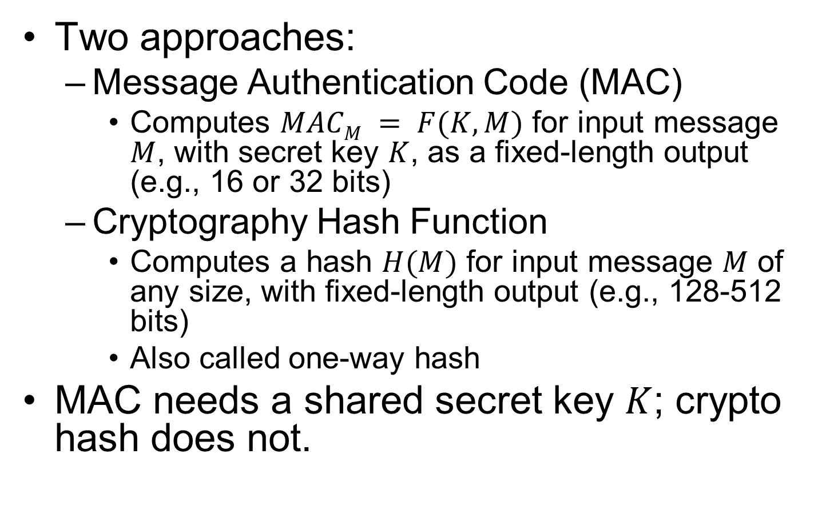
Message Authentication without Encryption
Two approaches:
Message Authentication Code (MAC)
Computes $MACM = F(K, M)$ for input message $M$, with secret key $K$, as a fixed-length output (e.g., 16 or 32 bits)
Cryptography Hash Function
Computes a hash $H(M)$ for input message $M$ of any size, with fixed-length output (e.g., 128-512 bits)
Also called one-way hash
MAC needs a shared secret key $K$; crypto hash does not.

Slide 23
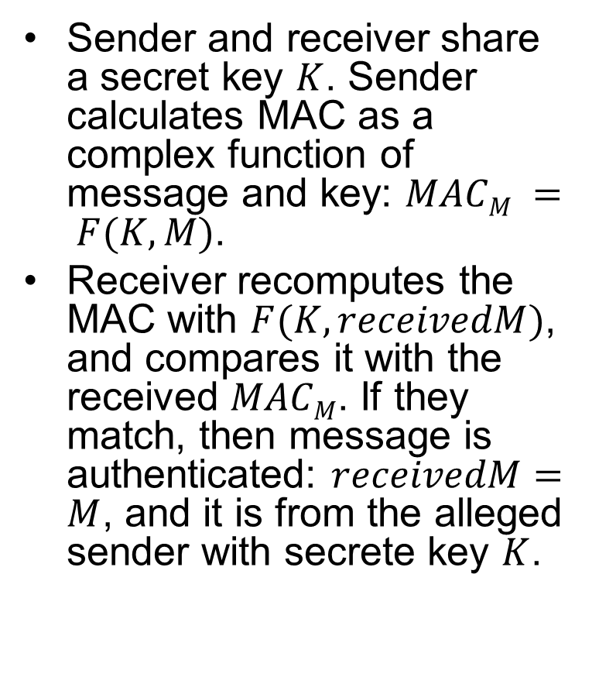
Message Authentication Code (MAC)
Sender and receiver share a secret key $K$. Sender calculates MAC as a complex function of message and key: $MACM = F(K, M)$.
Receiver recomputes the MAC with $F(K, receivedM)$, and compares it with the received $MACM$. If they match, then message is authenticated: $receivedM=M$, and it is from the alleged sender with secrete key $K$.
Notes:
One authentication technique involves
the use of a secret key to generate a small block of data, known as a message
authentication code, that is appended to the message. This technique assumes that
two communicating parties, say A and B, share a common secret key K_{AB}. When
A has a message to send to B, it calculates the message authentication code as a
complex function of the message and the key: MAC_{M} F(K_{AB}, M). The message
plus code are transmitted to the intended recipient. The recipient performs the same
calculation on the received message, using the same secret key, to generate a new
message authentication code. The received code is compared to the calculated code
(Figure 2.3). If we assume that only the receiver and the sender know the identity of
the secret key, and if the received code matches the calculated code, then
1. The receiver is assured that the message has not been altered. If an attacker
alters the message but does not alter the code, then the receiver’s calculation
of the code will differ from the received code. Because the attacker is assumed
not to know the secret key, the attacker cannot alter the code to correspond to
the alterations in the message.
2. The receiver is assured that the message is from the alleged sender. Because
no one else knows the secret key, no one else could prepare a message with a
proper code.
3. If the message includes a sequence number (such as is used with X.25, HDLC,
and TCP), then the receiver can be assured of the proper sequence, because
an attacker cannot successfully alter the sequence number.
A number of algorithms could be used to generate the code. The NIST specification,
FIPS PUB 113, recommends the use of DES. DES is used to generate an
encrypted version of the message, and the last number of bits of ciphertext are used
as the code. A 16- or 32-bit code is typical.
The process just described is similar to encryption. One difference is that the
authentication algorithm need not be reversible, as it must for decryption. It turns
out that because of the mathematical properties of the authentication function, it is
less vulnerable to being broken than encryption.

Slide 24
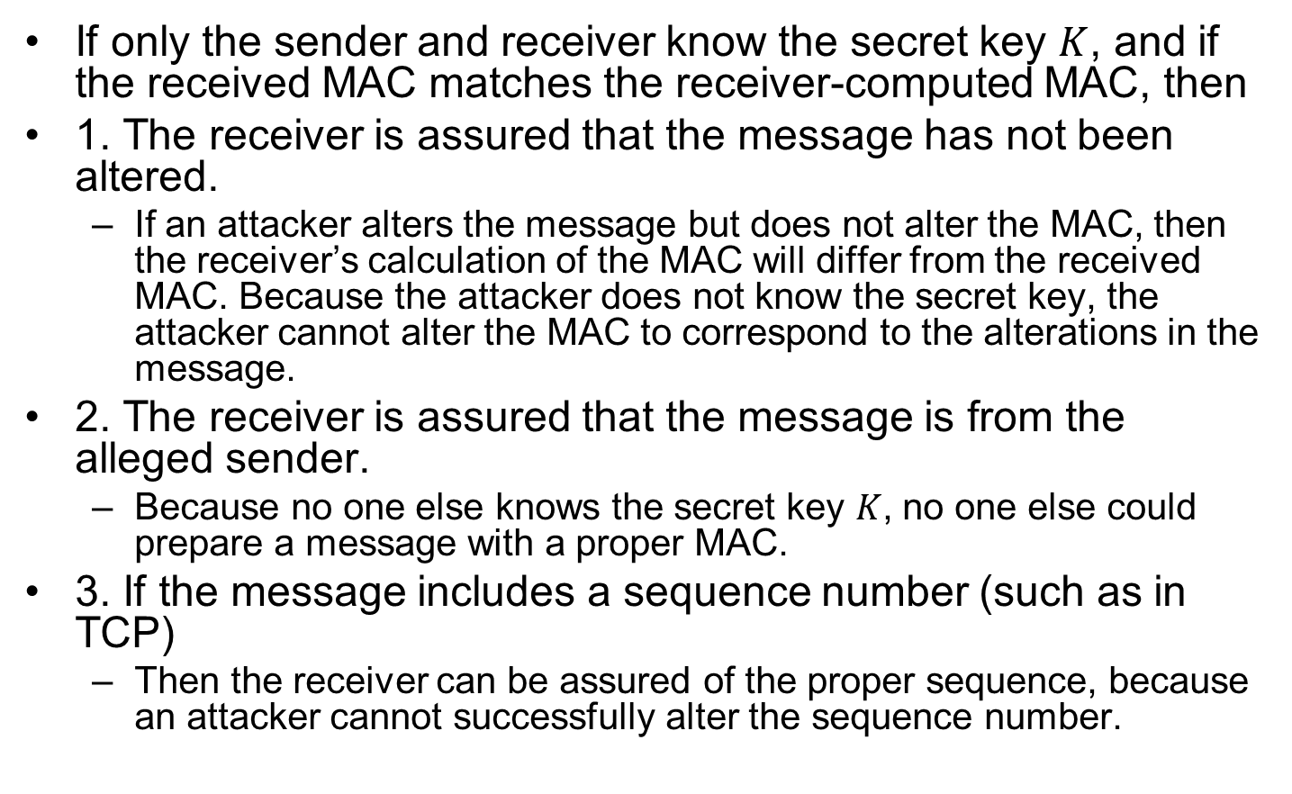
MAC Explanations
If only the sender and receiver know the secret key $K$, and if the received MAC matches the receiver-computed MAC, then
1. The receiver is assured that the message has not been altered.
If an attacker alters the message but does not alter the MAC, then the receiver’s calculation of the MAC will differ from the received MAC. Because the attacker does not know the secret key, the attacker cannot alter the MAC to correspond to the alterations in the message.
2. The receiver is assured that the message is from the alleged sender.
Because no one else knows the secret key $K$, no one else could prepare a message with a proper MAC.
3. If the message includes a sequence number (such as in TCP)
Then the receiver can be assured of the proper sequence, because an attacker cannot successfully alter the sequence number.

Slide 25
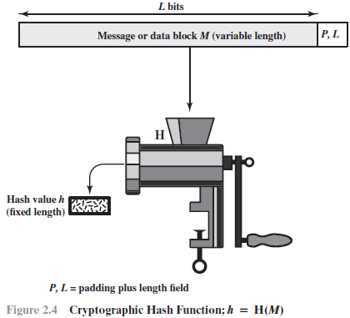
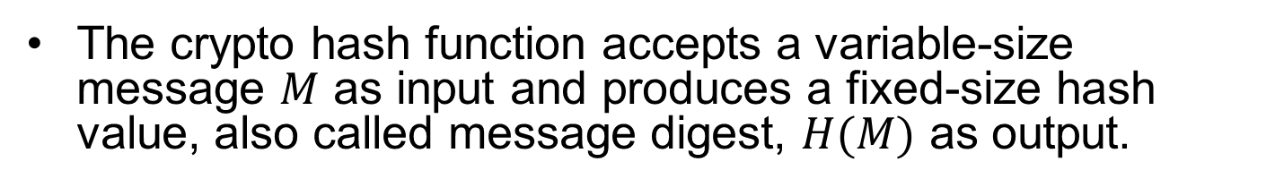
Crypto Hash Function
The crypto hash function accepts a variable-size message $M$ as input and produces a fixed-size hash value, also called message digest, $H(M)$ as output.

Slide 26
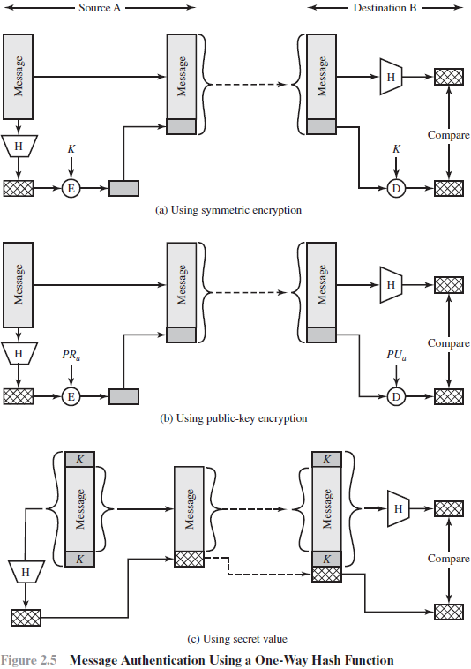
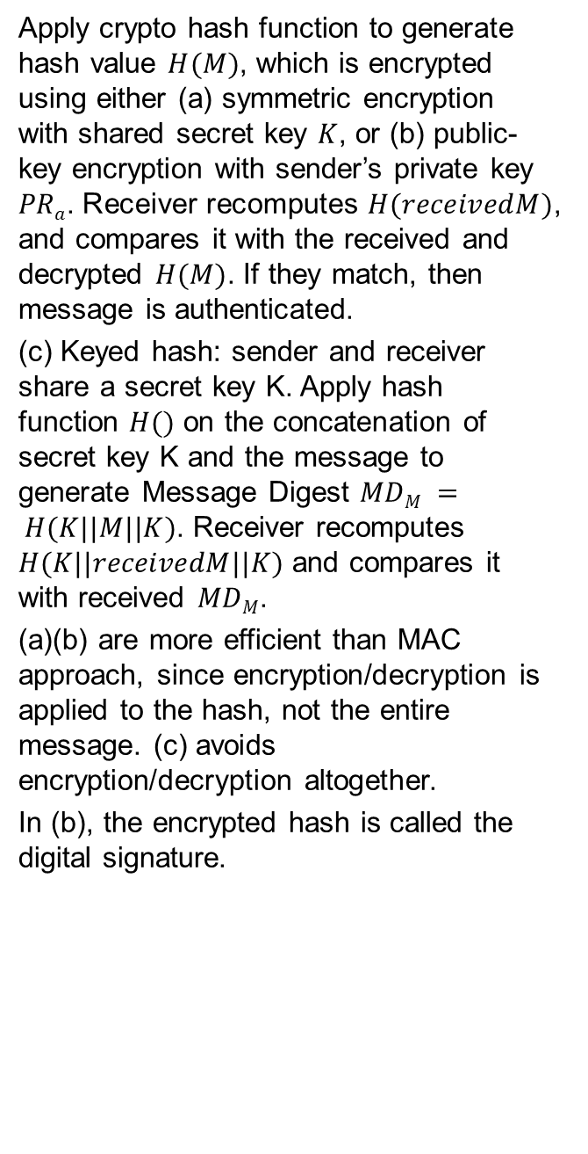
Apply crypto hash function to generate hash value $H(M)$, which is encrypted using either (a) symmetric encryption with shared secret key $K$, or (b) public-key encryption with sender’s private key $PRa$. Receiver recomputes $H(receivedM)$, and compares it with the received and decrypted $H(M)$. If they match, then message is authenticated.
(c) Keyed hash: sender and receiver share a secret key K. Apply hash function $H()$ on the concatenation of secret key K and the message to generate Message Digest $MDM = H(K||M||K)$. Receiver recomputes $H(K||receivedM||K)$ and compares it with received $MDM$.
(a)(b) are more efficient than MAC approach, since encryption/decryption is applied to the hash, not the entire message. (c) avoids encryption/decryption altogether.
In (b), the encrypted hash is called the digital signature.
Notes:
It is efficient since no encryption/decryption is used.

Slide 27
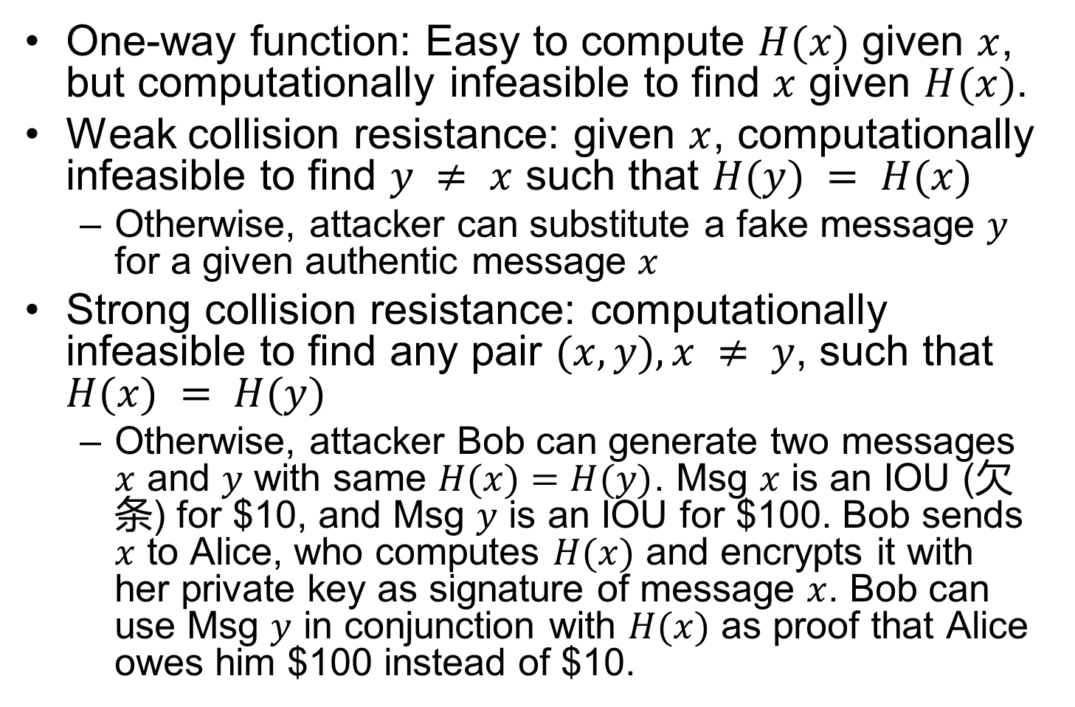
Crypto Hash Function Requirements
One-way function: Easy to compute $H(x)$ given $x$, but computationally infeasible to find $x$ given $H(x)$.
Weak collision resistance: given $x$, computationally infeasible to find $y ≠ x$ such that $H(y) = H(x)$
Otherwise, attacker can substitute a fake message $y$ for a given authentic message $x$
Strong collision resistance: computationally infeasible to find any pair $(x,y), x ≠ y$, such that $H(x) = H(y)$
Otherwise, attacker Bob can generate two messages $x$ and $y$ with same $H(x)=H(y)$. Msg $x$ is an IOU (欠条) for $10, and Msg $y$ is an IOU for $100. Bob sends $x$ to Alice, who computes $H(x)$ and encrypts it with her private key as signature of message $x$. Bob can use Msg $y$ in conjunction with $H(x)$ as proof that Alice owes him $100 instead of $10.
Notes:
An alternative to the message authentication code is the
one-way hash function. As with the message authentication code, a hash function
accepts a variable-size message M as input and produces a fixed-size message digest
H(M) as output (Figure 2.4). Typically, the message is padded out to an integer multiple
of some fixed length (e.g., 1024 bits) and the padding includes the value of the length
of the original message in bits. The length field is a security measure to increase the
difficulty for an attacker to produce an alternative message with the same hash value.
Unlike the MAC, a hash function does not also take a secret key as input.
To authenticate a message, the message digest is sent with the message in such
a way that the message digest is authentic. Figure 2.5 illustrates three ways in
which the message can be authenticated using a hash code. The message digest
can be encrypted using symmetric encryption (part a); if it is assumed that only
the sender and receiver share the encryption key, then authenticity is assured. The
message digest can also be encrypted using public-key encryption (part b); this is
explained in Section 2.3. The public-key approach has two advantages: It provides
a digital signature as well as message authentication; and it does not require the
distribution of keys to communicating parties.
These two approaches have an advantage over approaches that encrypt the
entire message in that less computation is required. But an even more common approach is
the use of a technique that avoids encryption altogether. Several reasons
for this interest are pointed out in [TSUD92]:
• Encryption software is quite slow. Even though the amount of data to be
encrypted per message is small, there may be a steady stream of messages into
and out of a system.
• Encryption hardware costs are non-negligible. Low-cost chip implementations
of DES are available, but the cost adds up if all nodes in a network must have
this capability.
• Encryption hardware is optimized toward large data sizes. For small blocks of
data, a high proportion of the time is spent in initialization/invocation overhead.
• An encryption algorithm may be protected by a patent.
Figure 2.5c shows a technique that uses a hash function but no encryption
for message authentication. This technique, known as a keyed hash MAC, assumes
that two communicating parties, say A and B, share a common secret key K.
This secret key is incorporated into the process of generating a hash code. In the
approach illustrated in Figure 2.5c, when A has a message to send to B, it calculates
the hash function over the concatenation of the secret key and the message:
MD_{M} = H(K ll M ll K). It then sends [ M ii MD_{M}] to B. Because B possesses K, it can
recompute H(K ll M ll K) and verify MD_{M}. Because the secret key itself is not sent, it
should not be possible for an attacker to modify an intercepted message. As long as
the secret key remains secret, it should not be possible for an attacker to generate a
false message.
Note that the secret key is used as both a prefix and a suffix to the message. If
the secret key is used as either only a prefix or only a suffix, the scheme is less secure.
This topic is discussed in Chapter 21. Chapter 21 also describes a scheme known
as HMAC, which is somewhat more complex than the approach of Figure 2.5c and
which has become the standard approach for a keyed hash MAC.

Slide 28
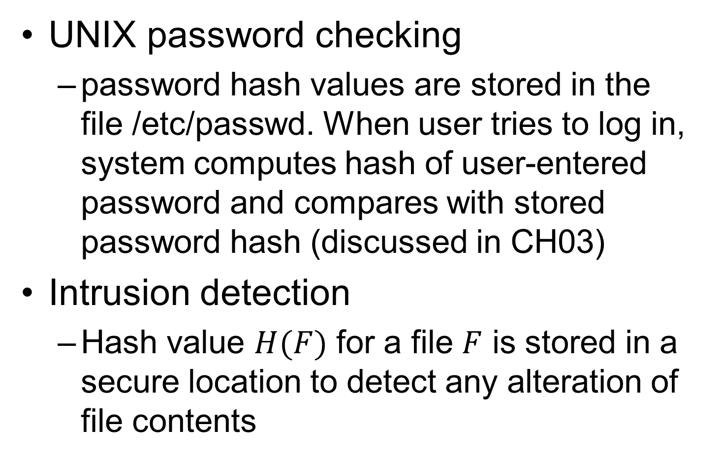
Additional Hash Function Applications
UNIX password checking
password hash values are stored in the file /etc/passwd. When user tries to log in, system computes hash of user-entered password and compares with stored password hash (discussed in CH03)
Intrusion detection
Hash value $H(F)$ for a file $F$ is stored in a secure location to detect any alteration of file contents

Slide 29
Random Numbers
Used to generate:
Keys for public-key algorithms
Stream key for symmetric stream cipher
Symmetric key for use as a temporary session key or in creating a digital envelope
Handshaking to prevent replay attacks
Session key
Notes:
A number of network security algorithms based on cryptography make use of
random numbers. For example,
• Generation of keys for the RSA public-key encryption algorithm (described
in Chapter 21) and other public-key algorithms.
• Generation of a stream key for symmetric stream cipher.
• Generation of a symmetric key for use as a temporary session key or in creating
a digital envelope.
• In a number of key distribution scenarios, such as Kerberos (described in
Chapter 23), random numbers are used for handshaking to prevent replay
attacks.
• Session key generation, whether done by a key distribution center or by one of
the principals.
These applications give rise to two distinct and not necessarily compatible
requirements for a sequence of random numbers: randomness and unpredictability.

Slide 30
Random Number Requirements
Randomness
Uniform distribution
Frequency of occurrence of each of the numbers should be approximately the same
Independence
No one value in the sequence can be inferred from the others
Unpredictability
Each number is statistically independent of others in the sequence, so future elements of the sequence cannot be predicted based on past elements
Notes:
Traditionally, the concern in the generation of a sequence of
allegedly random numbers has been that the sequence of numbers be random in
some well-defined statistical sense. The following two criteria are used to validate
that a sequence of numbers is random:
• Uniform distribution: The distribution of numbers in the sequence should be
uniform; that is, the frequency of occurrence of each of the numbers should be
approximately the same.
• Independence: No one value in the sequence can be inferred from the others.
Although there are well-defined tests for determining that a sequence of numbers
matches a particular distribution, such as the uniform distribution, there is no such
test to “prove” independence. Rather, a number of tests can be applied to demonstrate
if a sequence does not exhibit independence. The general strategy is to apply a number
of such tests until the confidence that independence exists is sufficiently strong.
In the context of our discussion, the use of a sequence of numbers that appear
statistically random often occurs in the design of algorithms related to cryptography.
In essence, if a problem is too hard or time-consuming to solve exactly, a simpler, shorter approach
based on randomization is used to provide an answer with any desired level of
confidence.
UNPREDICTABILITY
In applications such as reciprocal authentication and session key
generation, the requirement is not so much that the sequence of numbers be statistically
random but that the successive members of the sequence are unpredictable. With
“true” random sequences, each number is statistically independent of other numbers
in the sequence and therefore unpredictable. However, as is discussed shortly, true
random numbers are not always used; rather, sequences of numbers that appear to
be random are generated by some algorithm. In this latter case, care must be taken
that an opponent not be able to predict future elements of the sequence on the basis
of earlier elements.

Slide 31
Pseudorandom vs. Random Numbers
Pseudorandom numbers are generated with deterministic algorithms with random seeds:
The same seed results in the same sequence of random numbers
The sequence produced are not truly statistically random, but may pass many reasonable tests of randomness
True random number generator (TRNG):
Uses a nondeterministic source to produce randomness
Most operate by measuring unpredictable natural processes
e.g. radiation, gas discharge, leaky capacitors
Notes:
Cryptographic applications typically make use of algorithmic techniques for random
number generation. These algorithms are deterministic and therefore produce
sequences of numbers that are not statistically random. However, if the algorithm is
good, the resulting sequences will pass many reasonable tests of randomness. Such
numbers are referred to as pseudorandom numbers.
You may be somewhat uneasy about the concept of using numbers generated
by a deterministic algorithm as if they were random numbers. Despite what might
be called philosophical objections to such a practice, it generally works. As one
expert on probability theory puts it [HAMM91],
For practical purposes we are forced to accept the awkward concept
of “relatively random” meaning that with regard to the proposed
use we can see no reason why they will not perform as if they were
random (as the theory usually requires). This is highly subjective
and is not very palatable to purists, but it is what statisticians regularly
appeal to when they take “a random sample”—they hope that
any results they use will have approximately the same properties as
a complete counting of the whole sample space that occurs in their
theory.
A true random number generator (TRNG) uses a nondeterministic source to
produce randomness. Most operate by measuring unpredictable natural processes,
such as pulse detectors of ionizing radiation events, gas discharge tubes, and leaky
capac itors. Intel has developed a commercially available chip that samples thermal
noise by amplifying the voltage measured across undriven resistors [JUN99].
A group at Bell Labs has developed a technique that uses the variations in the
response time of raw read requests for one disk sector of a hard disk [JAKO98].
LavaRnd is an open source project for creating truly random numbers using inexpensive
cameras, open source code, and inexpensive hardware. The system uses a
saturated charge- coupled device (CCD) in a light-tight can as a chaotic source to
produce the seed. Software processes the result into truly random numbers in a
variety of formats.

